Slide 1
SE 181 UML Class Diagrams

Slide 2
Class Diagrams
The class diagram describes classes and shows the relationships between them.
A rectangle represents a class with it’s name at the top.
The next section of the rectangle lists the attributes in the class.
Each attribute contains:
A scope identifier (public (+), private (-), protected (#)).
The name of the attribute
A colon
The data type of the attribute

Slide 3
Class Diagrams (cont’d)
The final section of the rectangle lists the methods of the class.
Each method contains:
A scope identifier (Public (+), private (-), protected (#).
The name of the method.
The parameters, if they exist, for the method.
A return value for the method, if it exists.

Slide 4
Class Diagrams (cont’d)
The following three figures show
just a class defined
a class with a public method
a class with a private attribute and a public method

Slide 5
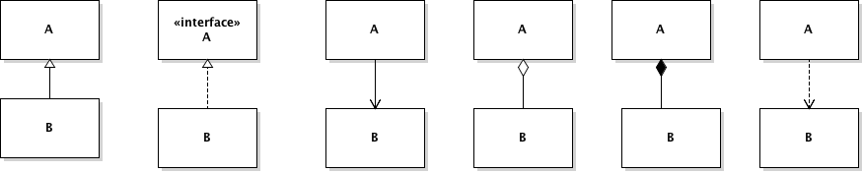
UML Notation for Relationships
The most common (from left to right):
B is derived from A
B implements A
A is associated with B
A aggregates B
A is composed of B
A depends on B

Slide 6
Class Relationships
What’s the difference between association, aggregation, and composition?
Association:
A more general form (than aggregation or composition) of representing (strong) dependency relationships among objects.
Bi-directional: Course objects need to know about students, and student objects need to know about the courses they are registered.
Directed: A message queue needs to be able to locate the messages, but a message need not need to know in which message queue it is.
Courses
Students
Message
Queue
Message

Slide 7
Class Relationships
Aggregation:
For all practical purposes the same as an association, but it is strictly a binary relationship between objects.
When the objects develop a Part-Whole relationship and the lifetime of Part doesn’t depend on the lifetime of Whole, the relationship is attributed as aggregation. (For example, CellBattery is a part of a CellPhone.)
Aggregation is also called a “Has-a” relationship.
In the case of association, there is no Part-Whole relationship.
Composition:
Composition is a special case of aggregation. The contained object cannot exist without the existence of container object.

Slide 8
Example #1
A Library contains books, which are written by authors, and catalogs.
Relationship between books and authors is ???.
Relationship between library and books is ???
Relationship between library and catalog is ???

Slide 9
Example #1
A Library contains books, which are written by authors, and catalogs.
Relationship between books and authors is association.
Relationship between library and books is aggregation (a book can exist without a library).
Relationship between library and catalog is composition (a catalog cannot exist without a library).

Slide 10
Example #2
Class diagram showing the is-a relationship.
Note there are no attributes or methods, just the relationships between classes.

Slide 11
Example #3
Class diagram, showing the has relationship between an airport and aircraft as well as the is-a relationship between a Jet/Helicopter and the Aircraft

Slide 12
Example #3 (cont’d)
Technically, the Aircraft is an abstract class.
In UML this is shown by writing the name of the class in italics.
Adding the word “Abstract” might make it more clear.

Slide 13
Adding Notes to Class Diagrams
UML gives you the ability to add notes to your diagram.

Slide 14
Cardinality
UML will also allow you to show cardinality.
In the diagram below, 1 car has 4 or 5 tires.
In addition, it shows that a car is dependent upon a gas station.

Slide 15
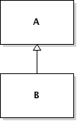
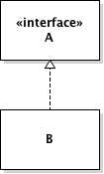
Relationships and Corresponding Code
Generalization (B is derived from A)
import A;
public class B extends A {
…
}
Realization (B implements A)
import A;
public class B implements A {
…
}

Slide 16

Relationships and Corresponding Code (cont’d)
Association -- Class A holds a class level reference to class B.
import B;
public class A {
private B b;
public B getB() {
return b;
}
}

Slide 17

Relationships and Corresponding Code (cont’d)
Aggregation -- for all practical purposes it is the same as association.
Composition -- class A instance owns the creation, or controls the lifetime of instance of class B.
public class B { … };
public class A {
B b = new B();
…
}

Slide 18

Relationships and Corresponding Code (cont’d)
Dependency -- indicates that class A uses class B, but that class A does not contain an instance of class B as part of its own state.
import B;
public class A {
public void method1(B b) {
…
}
public void method2() {
// local instance reference inside a method
B tempB = new B();
}
}

Slide 19
Summary
A class “depends” on another class if it manipulates objects of the other class in any way.
Aggregation takes place if objects of one class contain object of another class over a period of time.
Aggregation is usually implemented through instance fields.
public class Mailbox { … private Greeting myGreeting; }
Composition is a stronger form of aggregation, where the contained objects do not have an existence independent of their containers.

